Slide 1

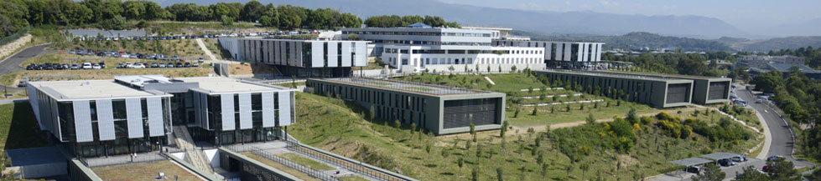



Laboratory of Electronics Antennas and Telecommunications
Tutorial on LoRaWAN
Member of Université Côte d’Azur

Slide 2
Outline
I. What is LoRaWAN ?
II. Class in LoRaWAN
III. Security
IV. Activation process
V. The Things Network

Slide 3
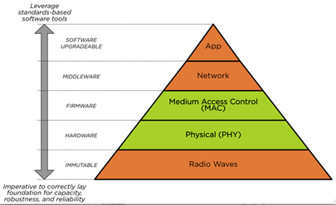
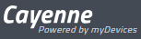
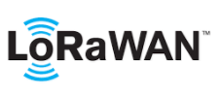

Medium Access Control (MAC)
Channel
Antenna

Slide 4
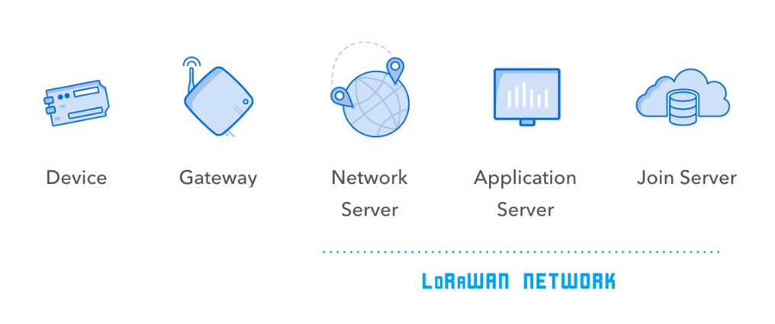
LoRaWan
LoRaWan is a software protocol using lora physical layer
LoRaWan include :
Session Layer
Network Layer
Data Link Layer
It defines the packet format, and the way the packet are processed by the network

Slide 5
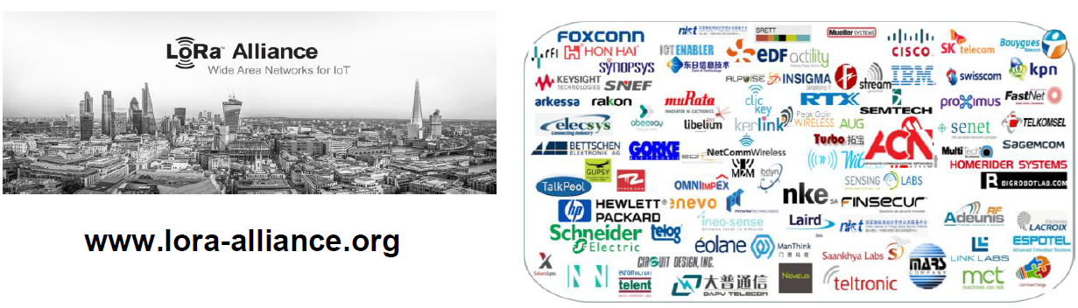
LoRaWan
LoRaWan is defined by the Lora alliance

Slide 6
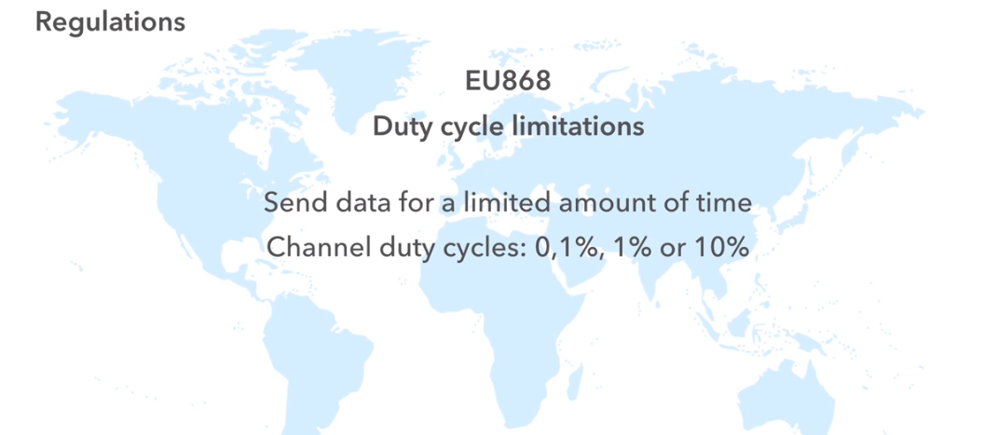
LoRaWan bands

Slide 7
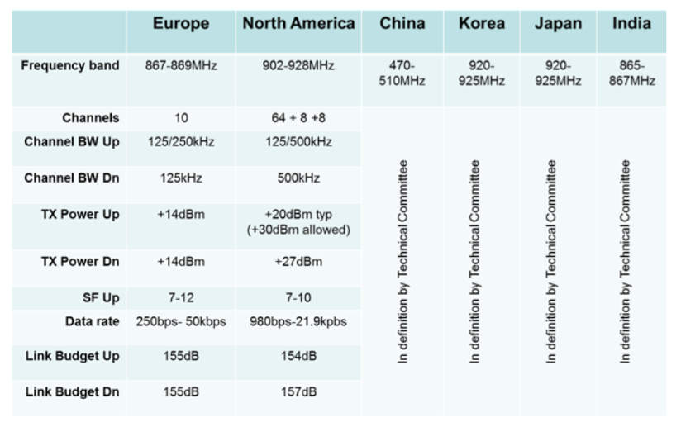
LoRaWan bands

Slide 8
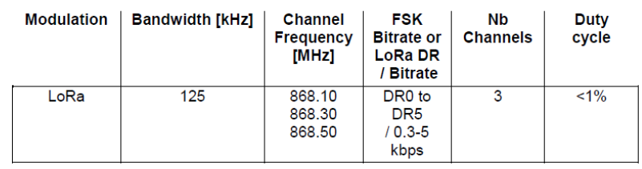
LoRaWan bands
License free Sub-GHz Frequencies :
Europe 868 MHz Band (863 ~ 870 MHz)
Network channels can be freely attributed by the network operator
Three mandatory channels that all gateways should constantly receive, and used by the end-points during the Join procedure :

Slide 9
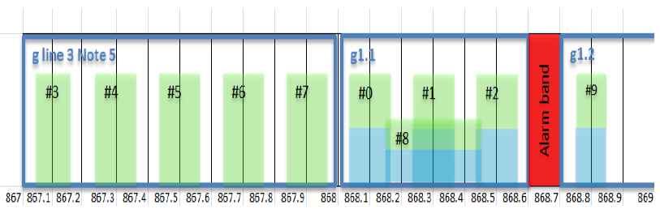
LoRaWan bands
8 channels with multi-datarate 240 bps to 5.5 kbps
1 high-speed LoRa channel 11 kbps
1 high speed GFSK channel 50 kbps

Slide 10
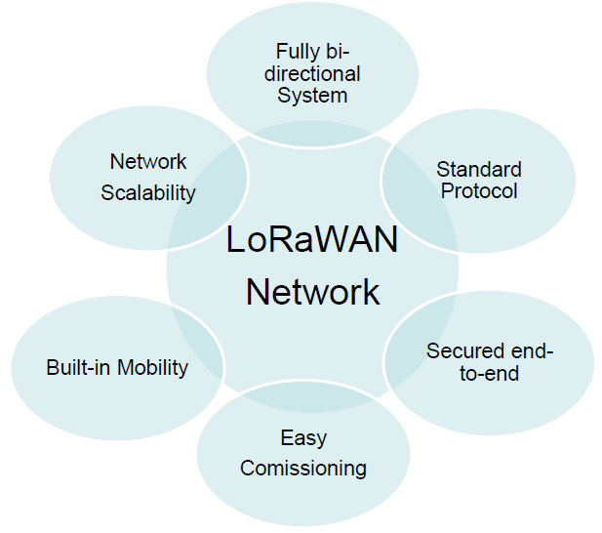
LoRaWan

Slide 11
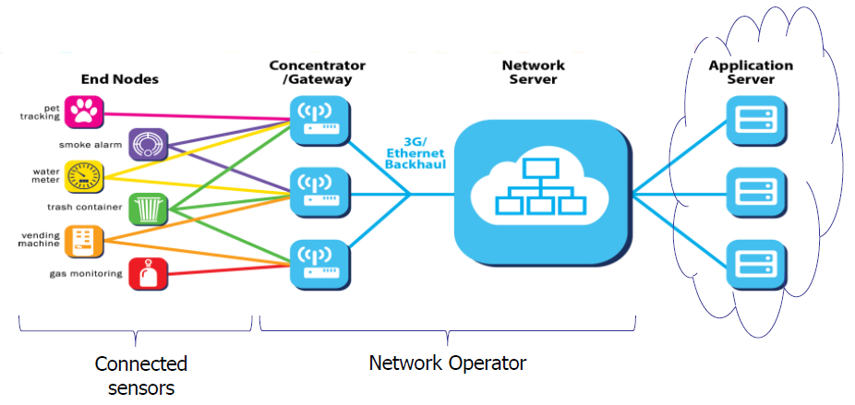
LoRaWan
Centralized intelligence, cloud based
▪ No notion of connection or pairing from GW to device
▪ Mostly uplink, Aloha type system
– IOT cannot support connection-based systems, from the energy standpoint
– Scheduling requires negociation and therefore energy
– Scheduling in a license-free band wouldn’t be efficient

Slide 12
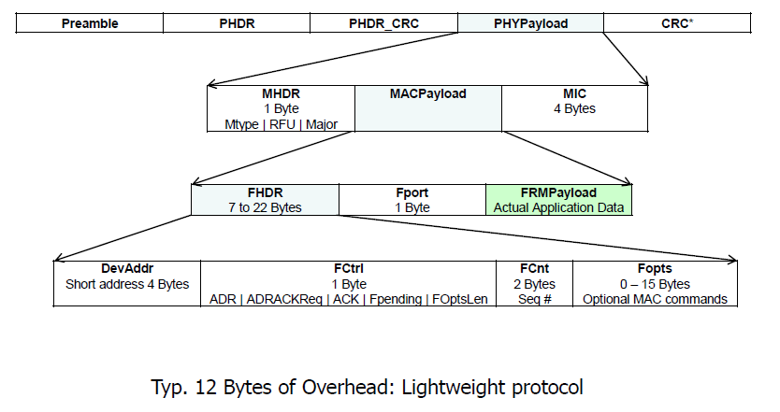
LoRaWan

Slide 13
Outline
I. What is LoRaWAN
II. Class in LoRaWAN
III. Security
IV. Activation process
V. The Things Network

Slide 14
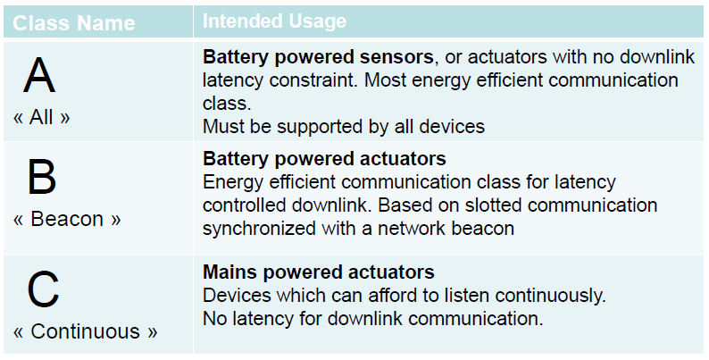
LoRaWan

Slide 15
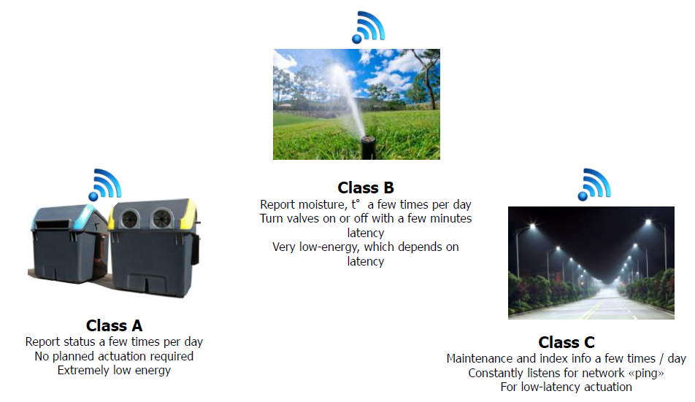
LoRaWan

Slide 16
LoRaWan – Class A
Bidirectional communication
Unicast messages
End-devices initiates communication (uplink)
Server communicates with end-device (downlink) during predetermined response windows
Pros : Lowest power consumption = longest battery life
Cons : downlink latency driven by the uplink pace

Slide 17
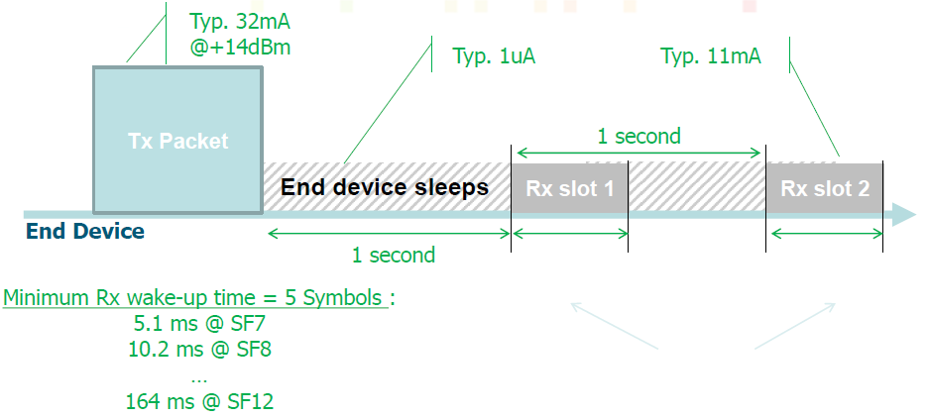
LoRaWan – Class A
No (wake-up time only) Rx Slot OR Rx Slot 1 OR Rx Slot 2 is used
The energy drain when no downlink is << the Tx energy

Slide 18
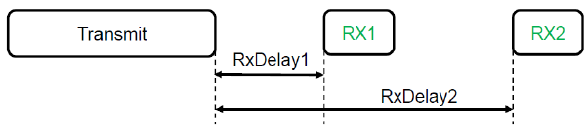
LoRaWan – Class A
First receive window «RX1» :
✓RxDelay1 is a fixed configurable delay in seconds. Default is 1 second.
✓RX1 frequency uses the same frequency channel as the uplink.
✓RX1 Data Rate is programmable, can equal or lower than the uplink data rate. By default the first receive window data rate is identical to the data rate of the last uplink.
Second receive window «RX2» :
✓RxDelay2 is a fixed configurable delay in seconds. Must be RxDelay1 + 1 second. Default is 2 seconds.
✓RX2 frequency is a fixed configurable frequency.
✓RX2 Data Rate is a fixed configurable data rate.

Slide 19
LoRaWan – Class A
Receive window duration :
The length of a receive wondow must be at least the time required by the end-device’s radio transciever to effectively detect a downlink preamble
Receiver activity during the receive windows :
If a preamble is detected during one the receive windows, the radio receiver stays active until the dowlink frame is demodulated.
Is Second receive window «RX2» mandatory ?
If the end-device did not receive the downlink frame during the first receive window “RX1”, it must open a second receive window “RX2”.
The end-device does not open the second receive window if a frame intended for this end-device has correctly checked the address and MIC (message integrity code) during the first receive window

Slide 20
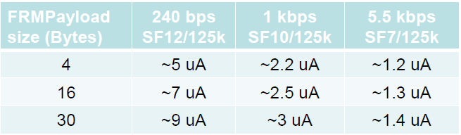
LoRaWan – Class A
Assumptions: Pout = +14 dBm, Average Current
10 packets / day
Sleep current ~1uA (includes the MCU)
MCU is mostly Off during Tx
No ACK received
The energy usage of the 2 unused Rx windows is low (<10%)
Pout = +14 dBm, IDDTX = 32 mA

Slide 21
LoRaWan – Class B
Bidirectional communication with scheduled receive slots
Unicast and Multicast messages
Periodic beacon from gateway
Extra receive windows
Server can initiate transmission at fixed intervals
Pros : deterministic downlink latency
Cons : higher power consumption
Low downlink latency end-device

Slide 22
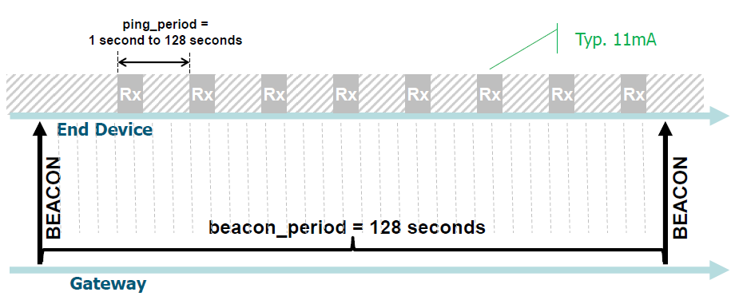
LoRaWan – Class B
Coordinated Sampled Listening : Network may send downlink packet to node at any Rx slot

Slide 23
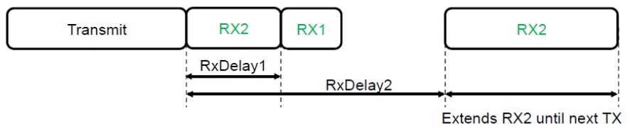
LoRaWan – Class C
No downlink latency end-device
Bidirectional communication
Unicast and Multicast messages
Server can initiate transmission at any time
End-device is constantly receiving
Pros : Lowest downlink latency
Cons : highest power consumption (expect end-device to be mains powered)

Slide 24
Adaptative datarate
ADR stands for Adaptive Data Rate.
It is the process of adapting the end-device’s transmitter output power, data rate and transmit diversity based on the average radio channel attenuation.
If the average radio link is good the data rate can be increased
If the demodulation is marginal, the data rate must be lowered
Consequence:
Identical end-devices in different locations might use different data rates / output power

Slide 25
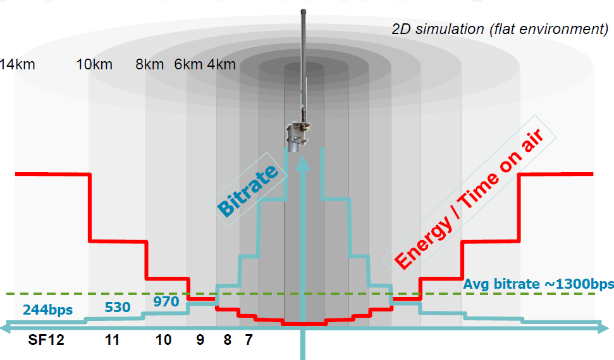
Adaptative datarate

Slide 26
Modulation settings
Longest distance on LoRa modulation :
Data Rate (DR) = 0
•LoRa modulation
•Spreading Factor (SF) = SF12
•Bandwidth (BW) = 125 kHz
•Coding Rate (CR) = 4/5
•Low Datarate Optimize = Enabled
Bit Rate = 244 bps
Receive Sensitivity = -137 dBm
Max Application Payload Size = 51 bytes
•Preambule (programmed) = 8 symbols
•Time On Air = 2466 ms

Slide 27
Modulation settings
Highest Bit Rate on LoRa modulation :
Data Rate (DR) = 6
•LoRa modulation
•Spreading Factor (SF) = SF7
•Bandwidth (BW) = 250 kHz
•Coding Rate (CR) = 4/5
•Low Datarate Optimize = Disabled
Bit Rate = 10938 bps
Receive Sensitivity = -124 dBm
Max Application Payload Size = 222 bytes
•Preambule (programmed) = 8 symbols
•Time On Air = 174 ms

Slide 28
Modulation settings
Highest Bit Rate on GFSK modulation :
Data Rate (DR) = 7
•GFSK modulation
Bit Rate = 50 kbps
Receive Sensitivity = -108 dBm
Max Application Payload Size = 222 bytes
•Time On Air = 39 ms

Slide 29
ADR
ADR must be handled differently for static & mobile end-devices.
Static end-devices experience pretty stable radio propagation to the surrounding gateways
The ADR is performed by the network server based on the history of the uplink packets received = Network managed ADR or Static ADR
This is a slow and gradual process
Mobile end-devices experience rapidly variable channel attenuations as they moved.
The network based ADR strategy cannot work because of the totally unpredictable channel attenuation as the device moves
ADR is performed “blindly” on the end-device side = blind ADR

Slide 30
Outline
I. What is LoRaWAN
II. Class in LoRaWAN
III. Security
IV. Activation process
V. The Things Network

Slide 31
Security
Encryption : One key field in security is encryption. It protects your data from being read everyone. As IoT may handle sensitive data, it's important for you to understand this concept as you may need to protect the information your device sends.
https://www.makeuseof.com/tag/encryption-care/
What is Encryption?
Encryption is a modern form of cryptography that allows a user to hide information from others. Encryption uses a complex algorithm called a cipher in order to turn normalized data (plaintext) into a series of seemingly random characters (ciphertext) that is unreadable by those without a special key in which to decrypt it. Those that possess the key can decrypt the data in order to view the plaintext again rather than the random character string of ciphertext.

Slide 32
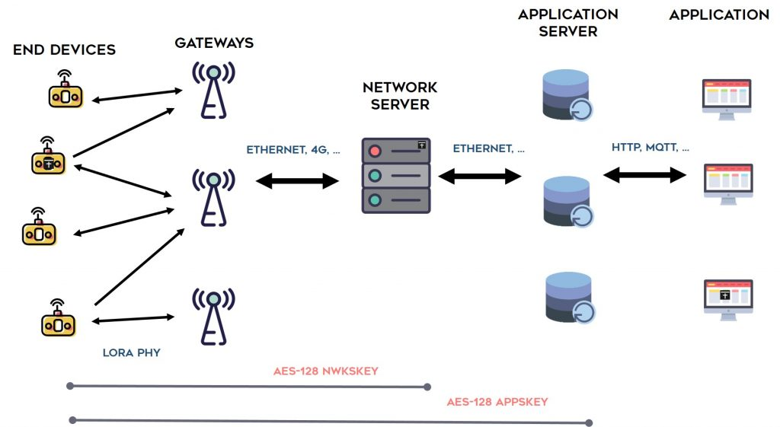
Security
Step1: Encryption: only FRMPayload is encrypted (1 to 1) with the 128-bit AppSKey
Step 2: Authentication: MIC is generated using the 128-bit NwkSKey, and appended to the frame for packet authentication

Slide 33
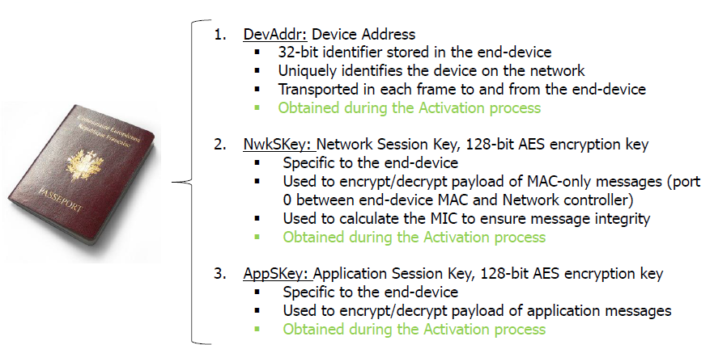
Security

Slide 34
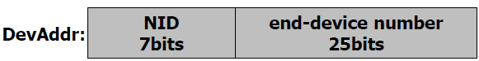
Security
DevAddr : Device 32 bits device address on a network. This address is dynamically set by the network operator during the on-boarding process .The same DevAddr can be reused in a network or across different networks. In case of address collision, the cryptographic signature allows to disambiguate
NID : The NID (Network Id) consists of the 7 LSB of the operator network ID (NetID) which is a 3 bytes unique network identifier allocated by the LoRa alliance . Two different networks must have different NetID but may end up with the same NID. The NID field eases the roaming process by reducing the amount of signaling required between Network Servers. Experimental/Private network must use 0000000 or 0000001 for NID.

Slide 35
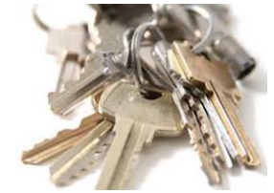
Security
The NwkSKey is a network session key specific for the end-devices. It is used by both the network server and the end-device to calculated and verify the MIC (message integrity code) of all data messages to ensure data integrity. It is further used to encrypt and decrypt the payload field of a MAC-only data messages.
The AppSKey is an application session key specific for the end-devices. It is used by both the application server and the end-device to encrypt and decrypt the payload field of application-specific data messages. It is also used to calculated and verify an application level MIC that may be included in the payload of application –specific data messages.

Slide 36
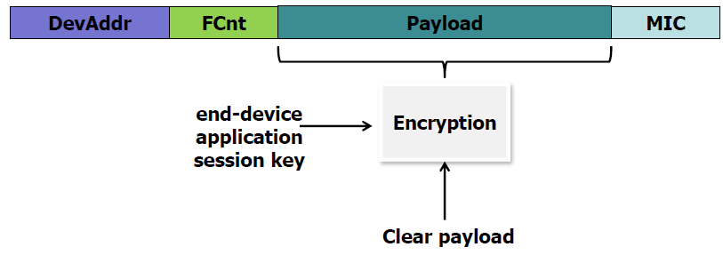
Step 1 : Payload Encryption
All payloads are encrypted using an AES algorithm with a 128bits secret key, the Application Session Key
Each end-device has its own unique Application Session Key only known by the end-device and the application server and only used for encryption

Slide 37
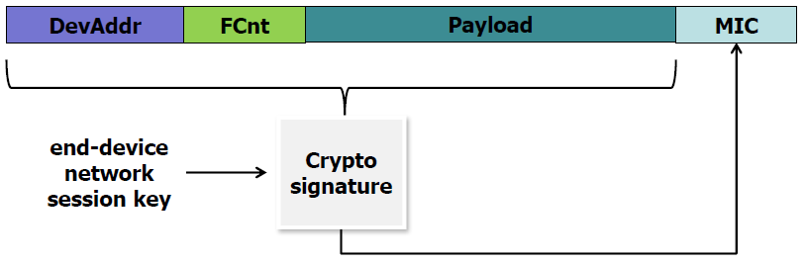
Step 2 : Packet authentification
All frames contain a 32bits cryptographic MIC signature computed using an AES algorithm with a 128bits secret key, the Network Session Key
The Network Session Key is different from the Application key Session
Each end-devices has its own Network Session Key only known by the end-device and the network server and only used for signature

Slide 38
Frame signature
The frame signature (Message Integrity Code “MIC”) is computed over the entire frame
Therefore the frame cannot be modified in any way between the end-device and the network server without compromising the signature.
The only components involved are:
The end-device
The network server
The gateway, the gateway backhaul link, etc, … are totally transparent from a security perspective

Slide 39
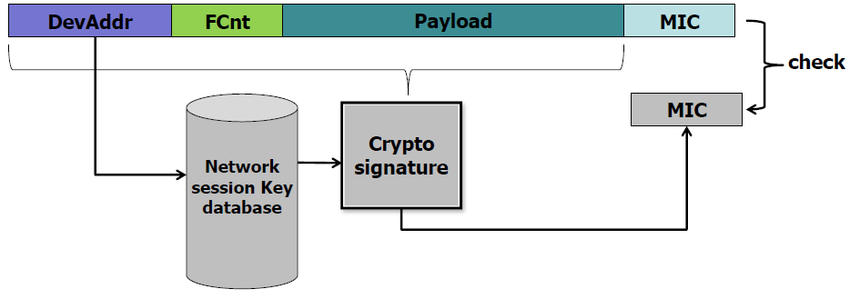
Authentification of the uplink
Upon reception of a frame, the network server checks that the frame received MIC signature matches the one computed using the end-device’s network session key contained in its key database
If the 2 MICs match then the frame is really coming from the legitimate end-device and its content hasn’t been modified in any way

Slide 40
Authentification of the downlink
The same process happens on the down-link.
The network server signs each frame with a MIC computed over the entire transmitted packet using the destination end-device’s Network Session Key.
This way, the server can differentiate a legitimate end-device from one trying to steal the end-device’s DevAddr (cloning attack).
The end-device can check that the commands coming from the network are legitimate.
Additionally each frame contains a frame counter forbidding “replay” attacks.

Slide 41
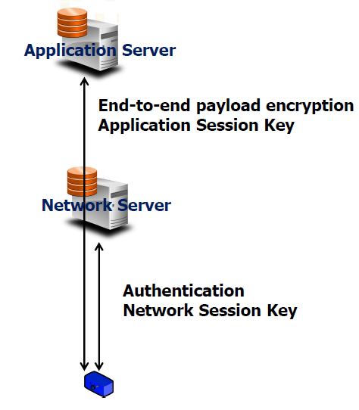
End to End security

Slide 42
Outline
I. What is LoRaWAN
II. Class in LoRaWAN
III. Security
IV. Activation process
V. The Things Network

Slide 43
End-device personalization and Activation
To participate in a LoRaWAN network, each end-device has to be personalized and activated :
Personalization : End-device is configured at production time.
Activation : Before an end-device can communicate on a LoRaWan network, it must be actived.

Slide 44
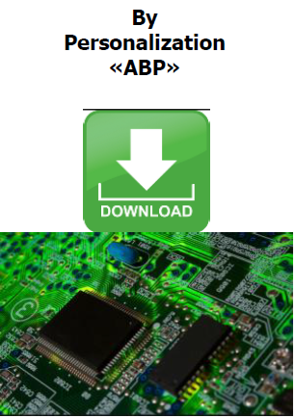
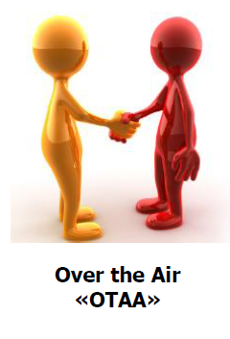
End-device Activation : 2 methods

Slide 45
Activation By Personalization
Network authority and Application provider negociate
▪A set of DevAddr (for instance 1000 Addresses, unique to the network)
▪A set of AppSKey
▪A set of NwkSKey
Advantage: devices are already pre-commissionned1
Drawback: roaming from network to network is impossible

Slide 46
Activation By Personalization
This is the simplest scenario , targeting mainly B2B use cases.
The device is registered by the service provider with a given network operator before being personalized.
The operator directly provides the correct DevAddr and network/app session keys The device is directly personalized at fabrication with the correct DevAddr and network+application session keys.
The device is fully functional on the network as soon as powered-up.
The device is therefore tied to a given network and service provider

Slide 47
Over the Air Activation “OTAA”
The join procedure requires the end-device to be personnalized with the following information before it starts the join procedure : a globally unique end-device identifier (DevEUI), the application identifier (AppEUI) and a an AES-128 key (AppKey)
DevEUI: unique source address identifying the node of the application provider
AppEUI: shared secret, destination address, globally unique identifier owned by the application provider. AppEUI routes the Join Req to the right Join Server
AppKey: used forJoinReq and JoinAccept authentication
Warning ! AppKey is different from AppSKey

Slide 48
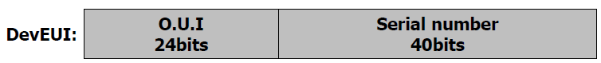
Over the Air Activation “OTAA”
DevEUI : Device 64 bits unique device identifier. Equivalent to the MAC address of a network adapter card. This address is written in the device by the manufacturer at the same time than the firmware. It consists of a 24bits Organizationally Unique Identifier (*) and a 40 bit serial number. The OUI code is unique for any manufacturer and provided by the IEEE and the serial code is set freely by the manufacturer.

Slide 49
Over the Air Activation “OTAA”
AppEUI : Join Server 64 bits unique server identifier. This number uniquely identifies a Join Server It consists of a 24bits Organizationally Unique Identifier (*) and a 40 bit serial number. The OUI code is the manufacturer’s code of the entity operating the Join Server. The serial number can be used if several Join Server are operated by the same entity. For example Semtech might operate a Join Server with AppEUI : 00 16 C0 00 00 00 00 01 “00 16 C0” is Semtech’s OUI

Slide 50
Over the Air Activation “OTAA”
The AppKey is an AES-128 application key specific for the end-device that is assigned by the application owner to the end-device and most likely derived from an application specific root key exclusively known to and under control of the application provider.
Whever an end-devices joins a network via OTAA, the AppKey is used to derive the session keys NwkSKey and AppSKey specific for the end-device to encrypt and verify network communication and application data.

Slide 51
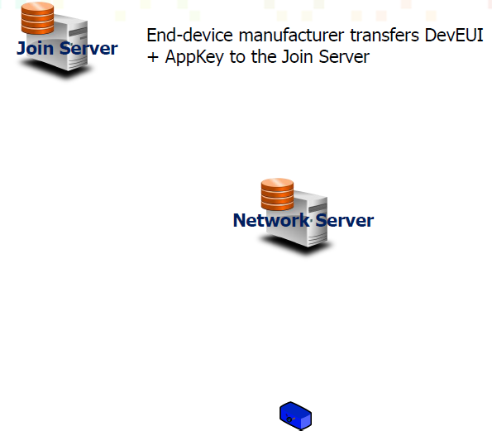
Over the Air Activation “OTAA”

Slide 52
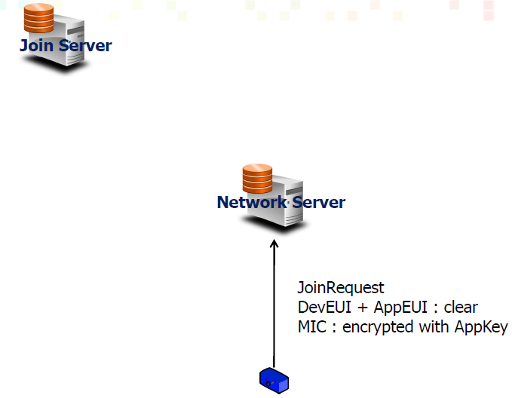
Over the Air Activation “OTAA”

Slide 53
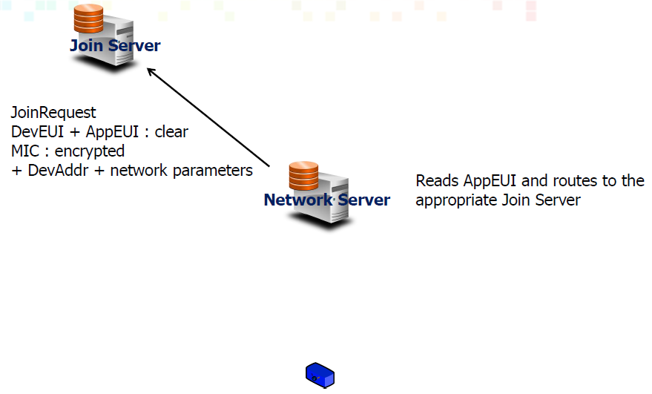
Over the Air Activation “OTAA”

Slide 54
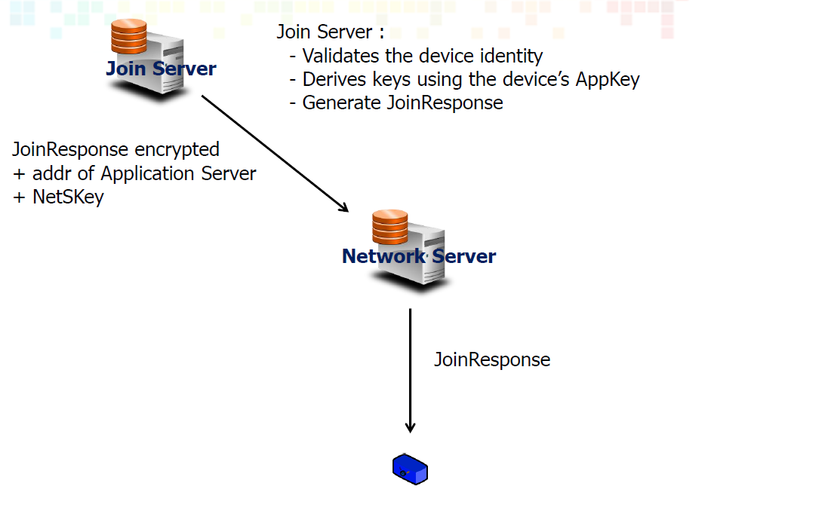
Over the Air Activation “OTAA”

Slide 55
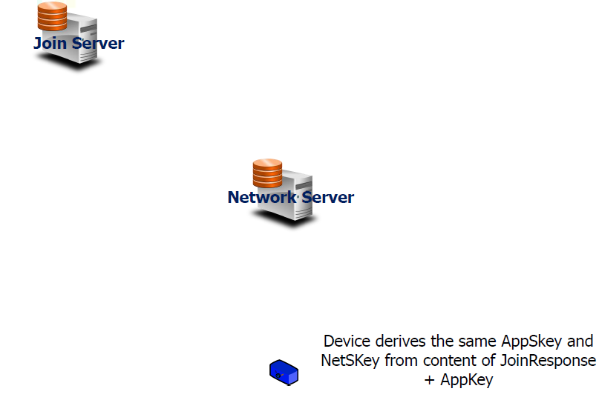
Over the Air Activation “OTAA”

Slide 56
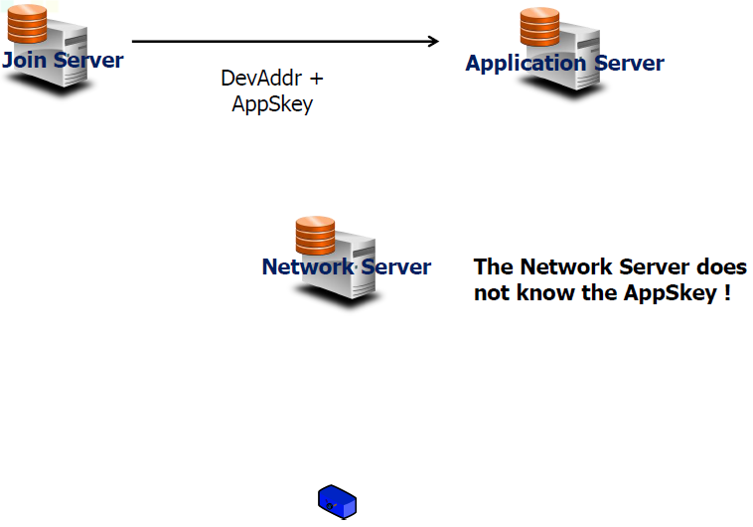
Over the Air Activation “OTAA”

Slide 57
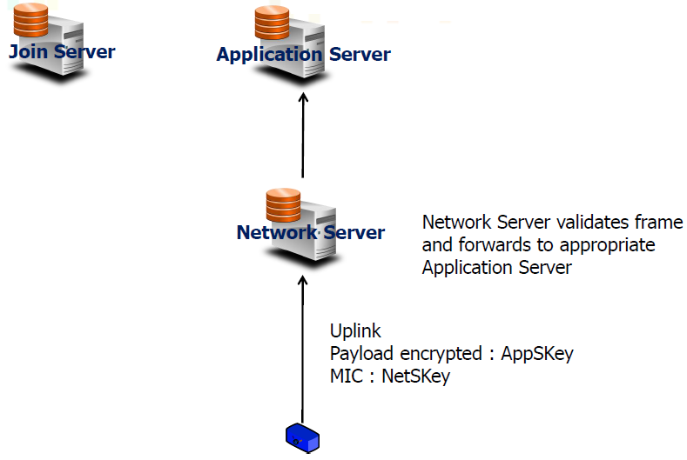
Over the Air Activation “OTAA”

Slide 58
Over the Air Activation “OTAA”
In this scenario the device is specific of a given service provider but is activated over-the-air on any network.
The device’s devEUI and AppKey (the device root key) are allocated autonomously by the device manufacturer.
The device’s AppEUI is set to point to the wanted Join Server (selected or operated by the service provider).
The device is service provider specific. The device is purchased by the service provider along with its devEUI and AppKey.
The device is activated over the air with the chosen operator. The same device can operate on any network and in different countries.
The selection of the operator is performed during the JoinReq –
JoinResponse message exchange.

Slide 59
Outline
I. What is LoRaWAN
II. Class in LoRaWAN
III. Security
IV. Activation process
V. The Things Network

Slide 60
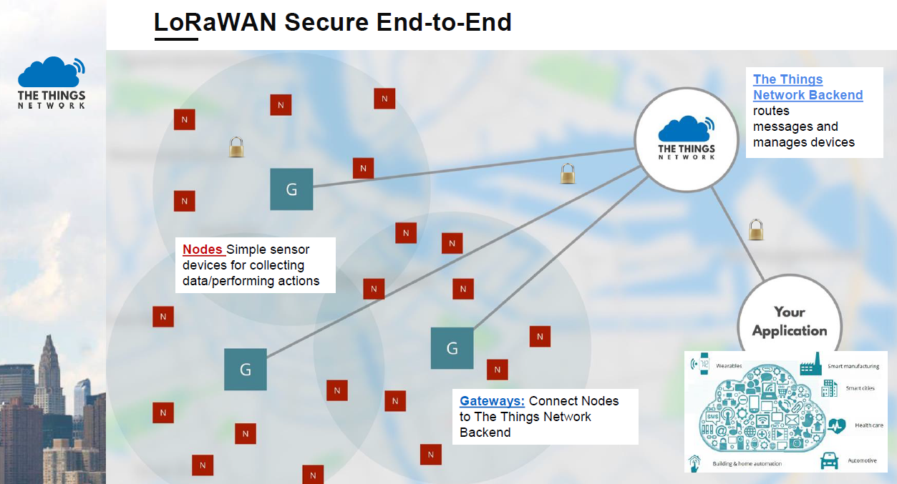
The Things Network

Slide 61

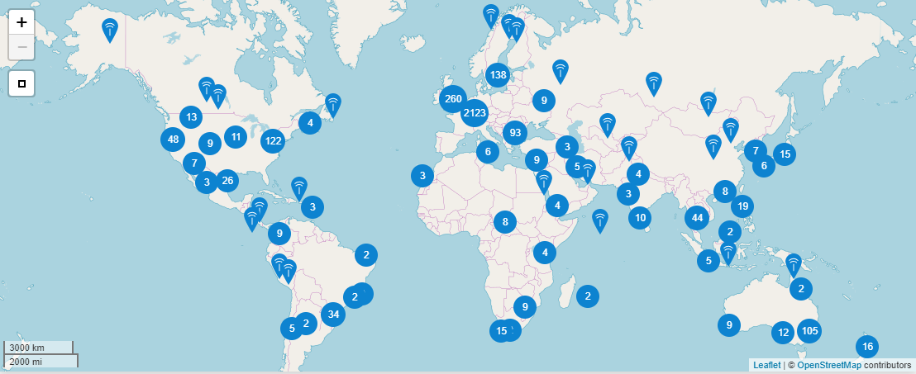
We are the network
The Things Network
Our network is built by us - the people. You can contribute by placing a gateway and expand our network. The more gateways are placed, the larger the coverage. At this moment, there are more than 7000 gateways up and running

Slide 62
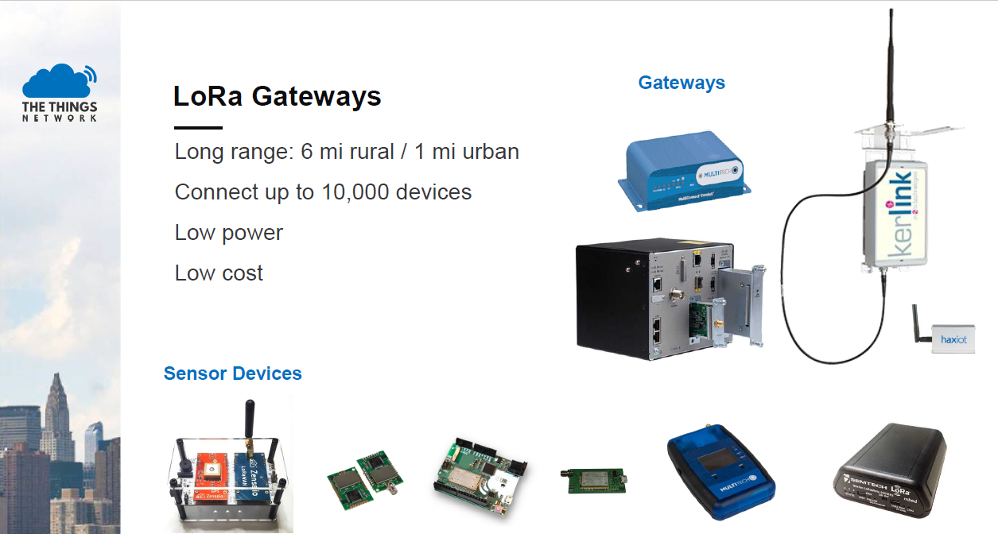
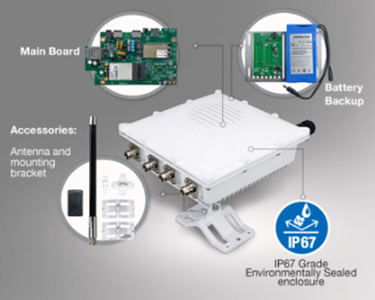
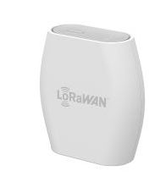
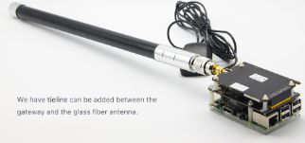
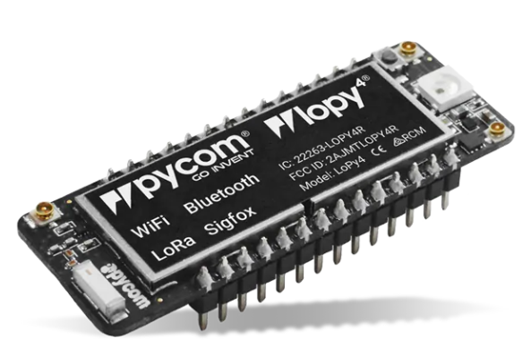
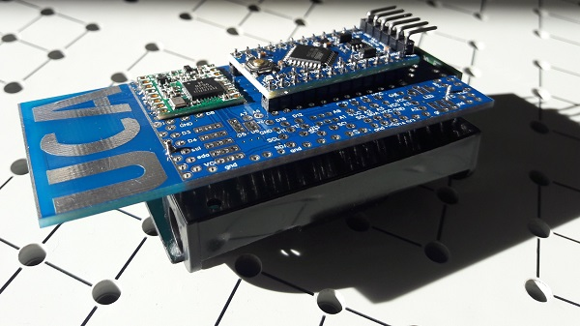
The Things Network
GATEWAY
85 €
< 200 €
< 10 €

Slide 63

Cote d’Azur TTN community
https://www.thethingsnetwork.org/community/Cote-dAzur/

Slide 64
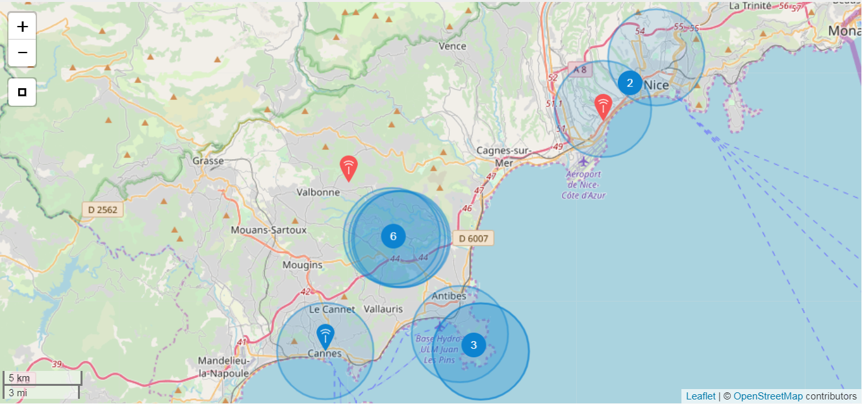
Cote d’Azur TTN community
10 gateways, more GW coming

Slide 65
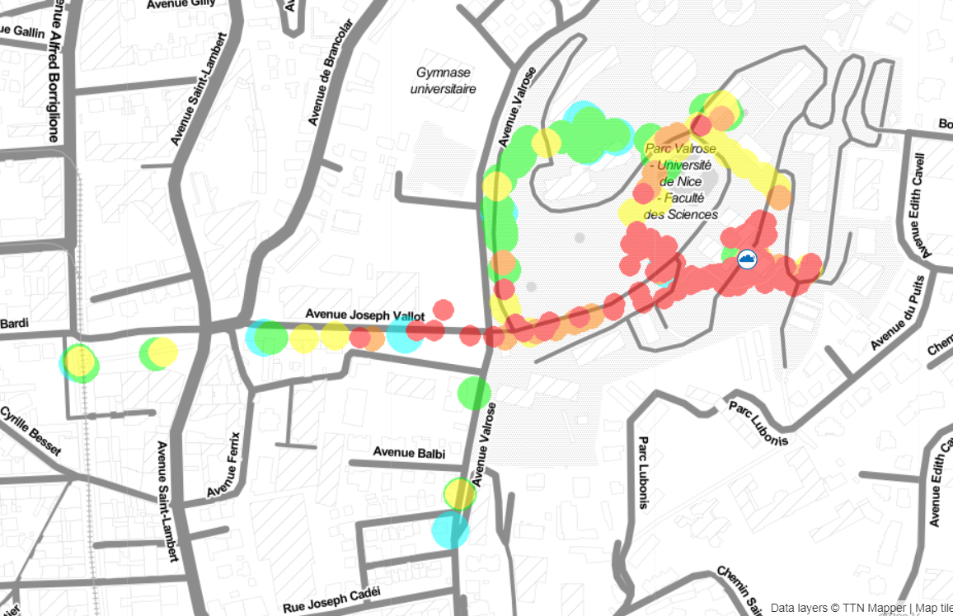
TTN Mapper
https://ttnmapper.org/

